Slide 1
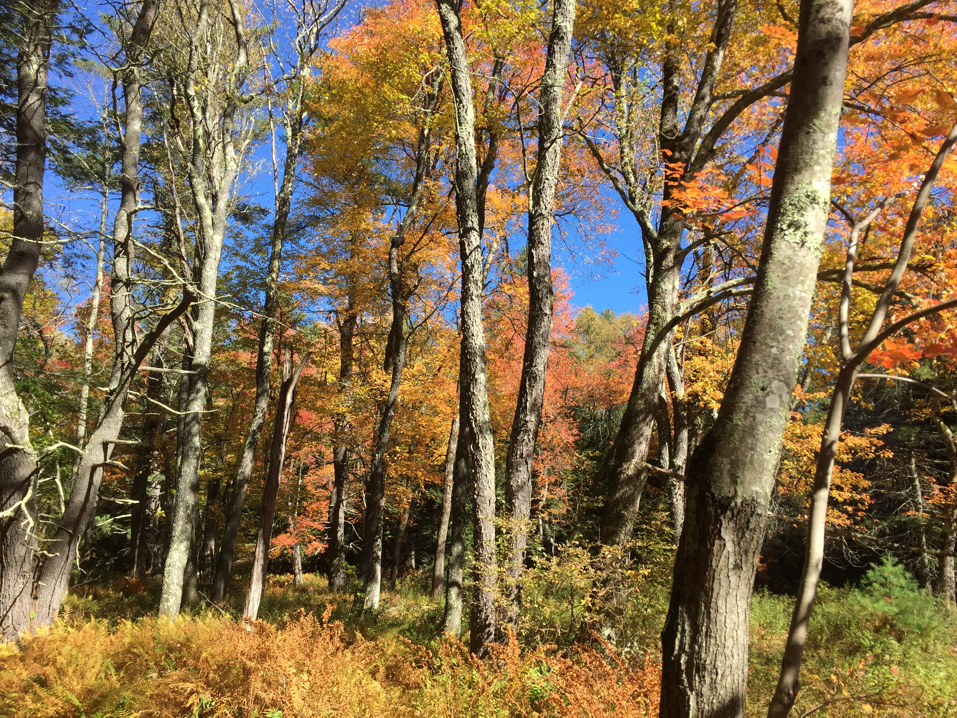
Understanding plant phenology in a warming world
Examining urban effects

Slide 2
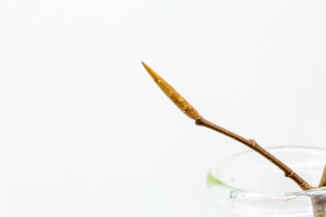
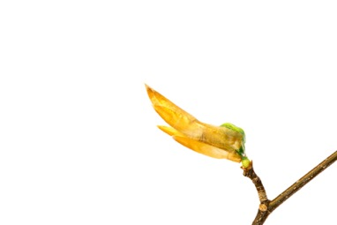
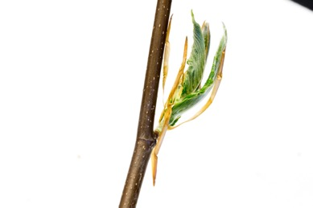
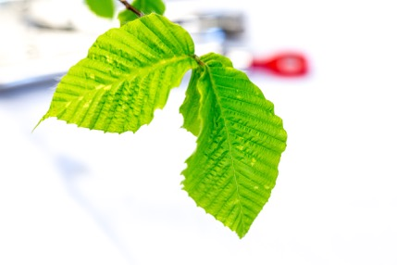
American Beech: Fagus sylvatica
DORMANT BUD
BUDBURST
LEAFOUT

Slide 3
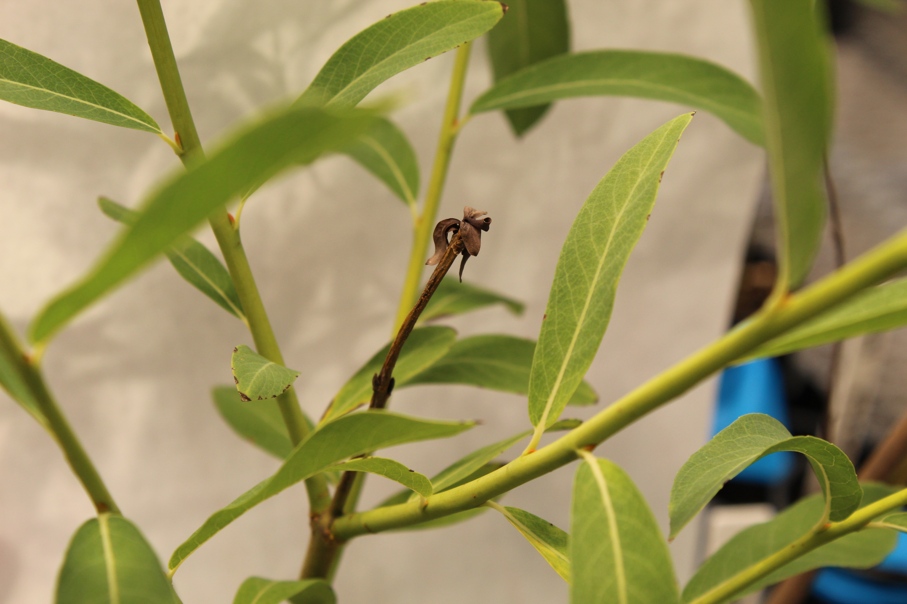
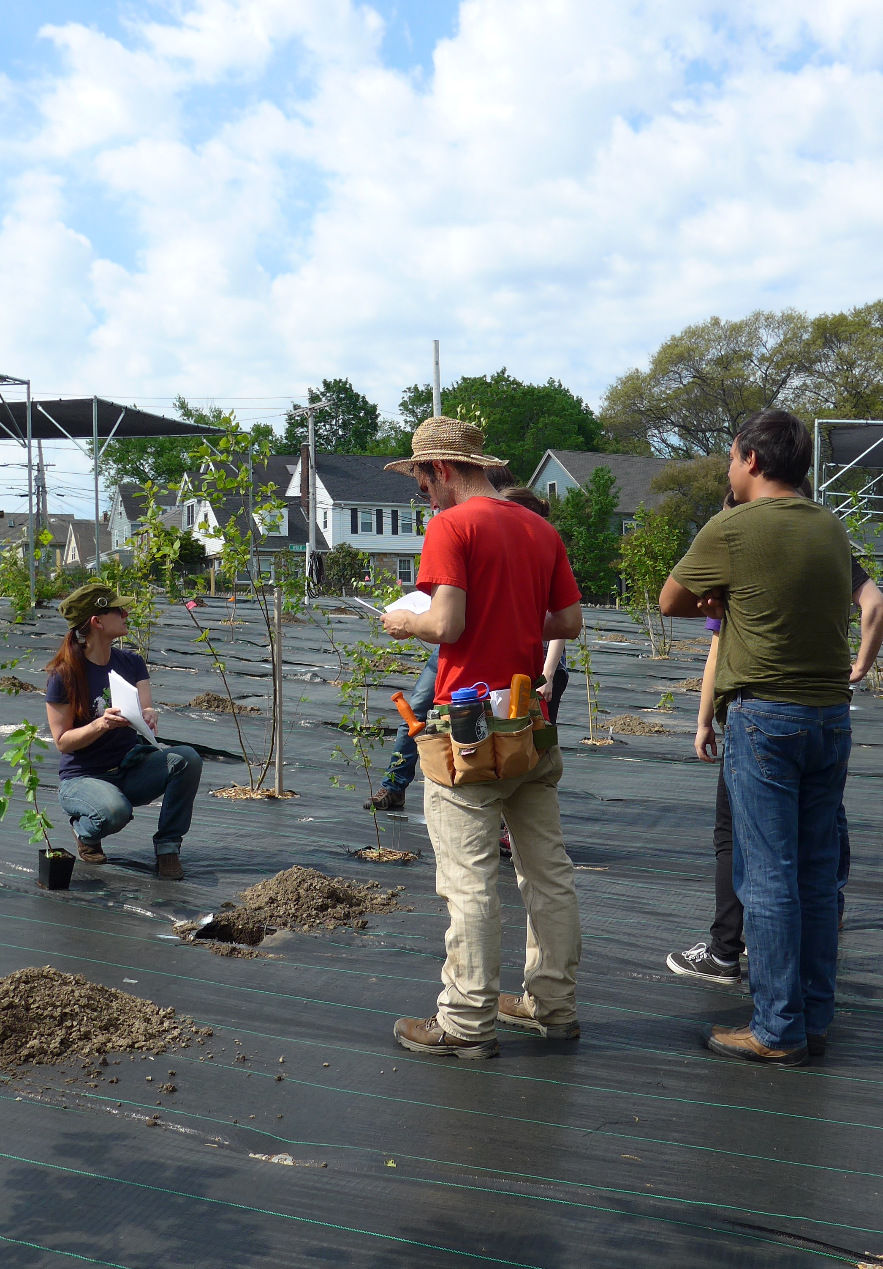
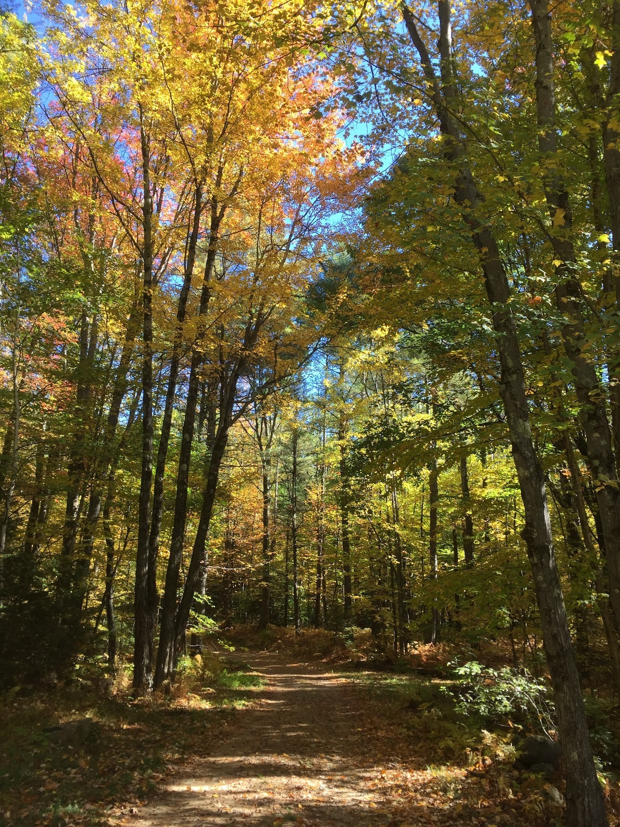
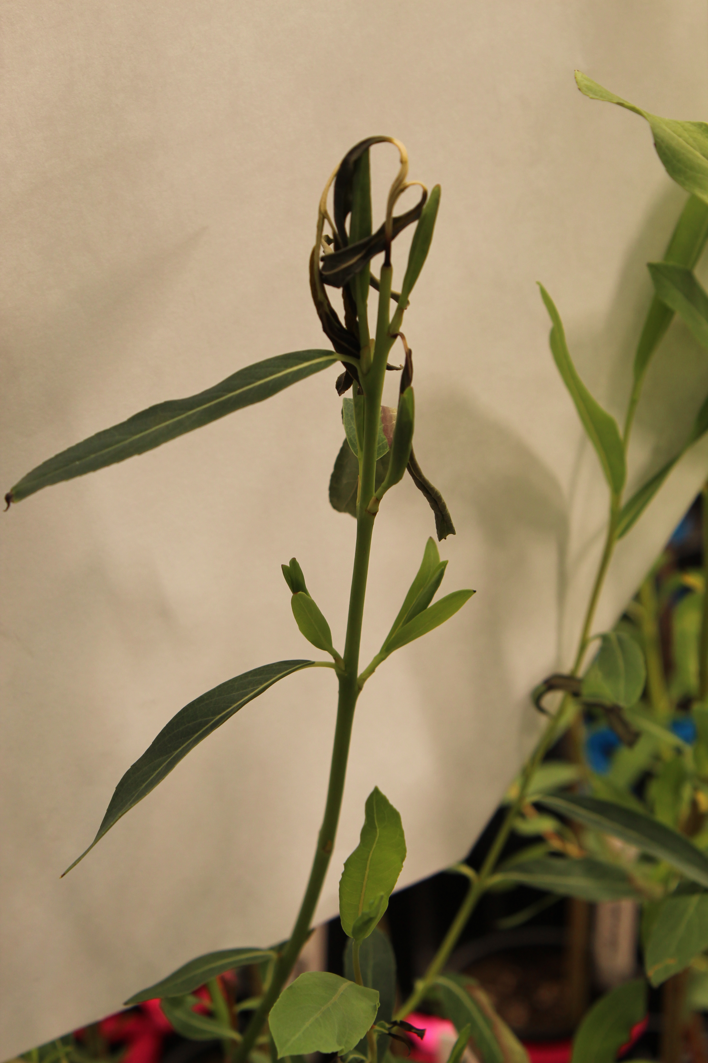
WHY IS PLANT PHENOLOGY SO IMPORTANT?
Spring Freeze Risk
Drought Risk
Growth Rate
Carbon Sinks

Slide 4
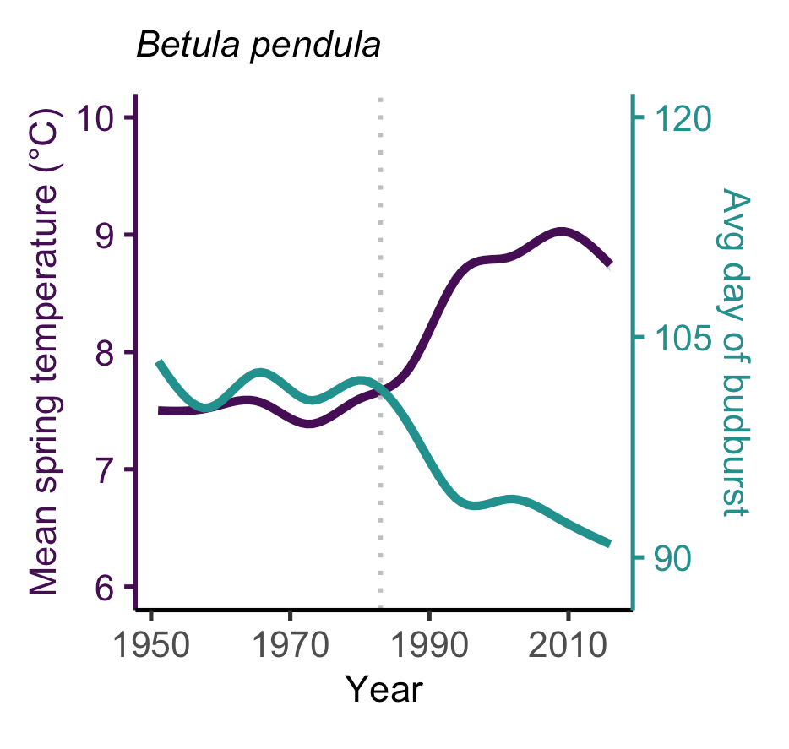
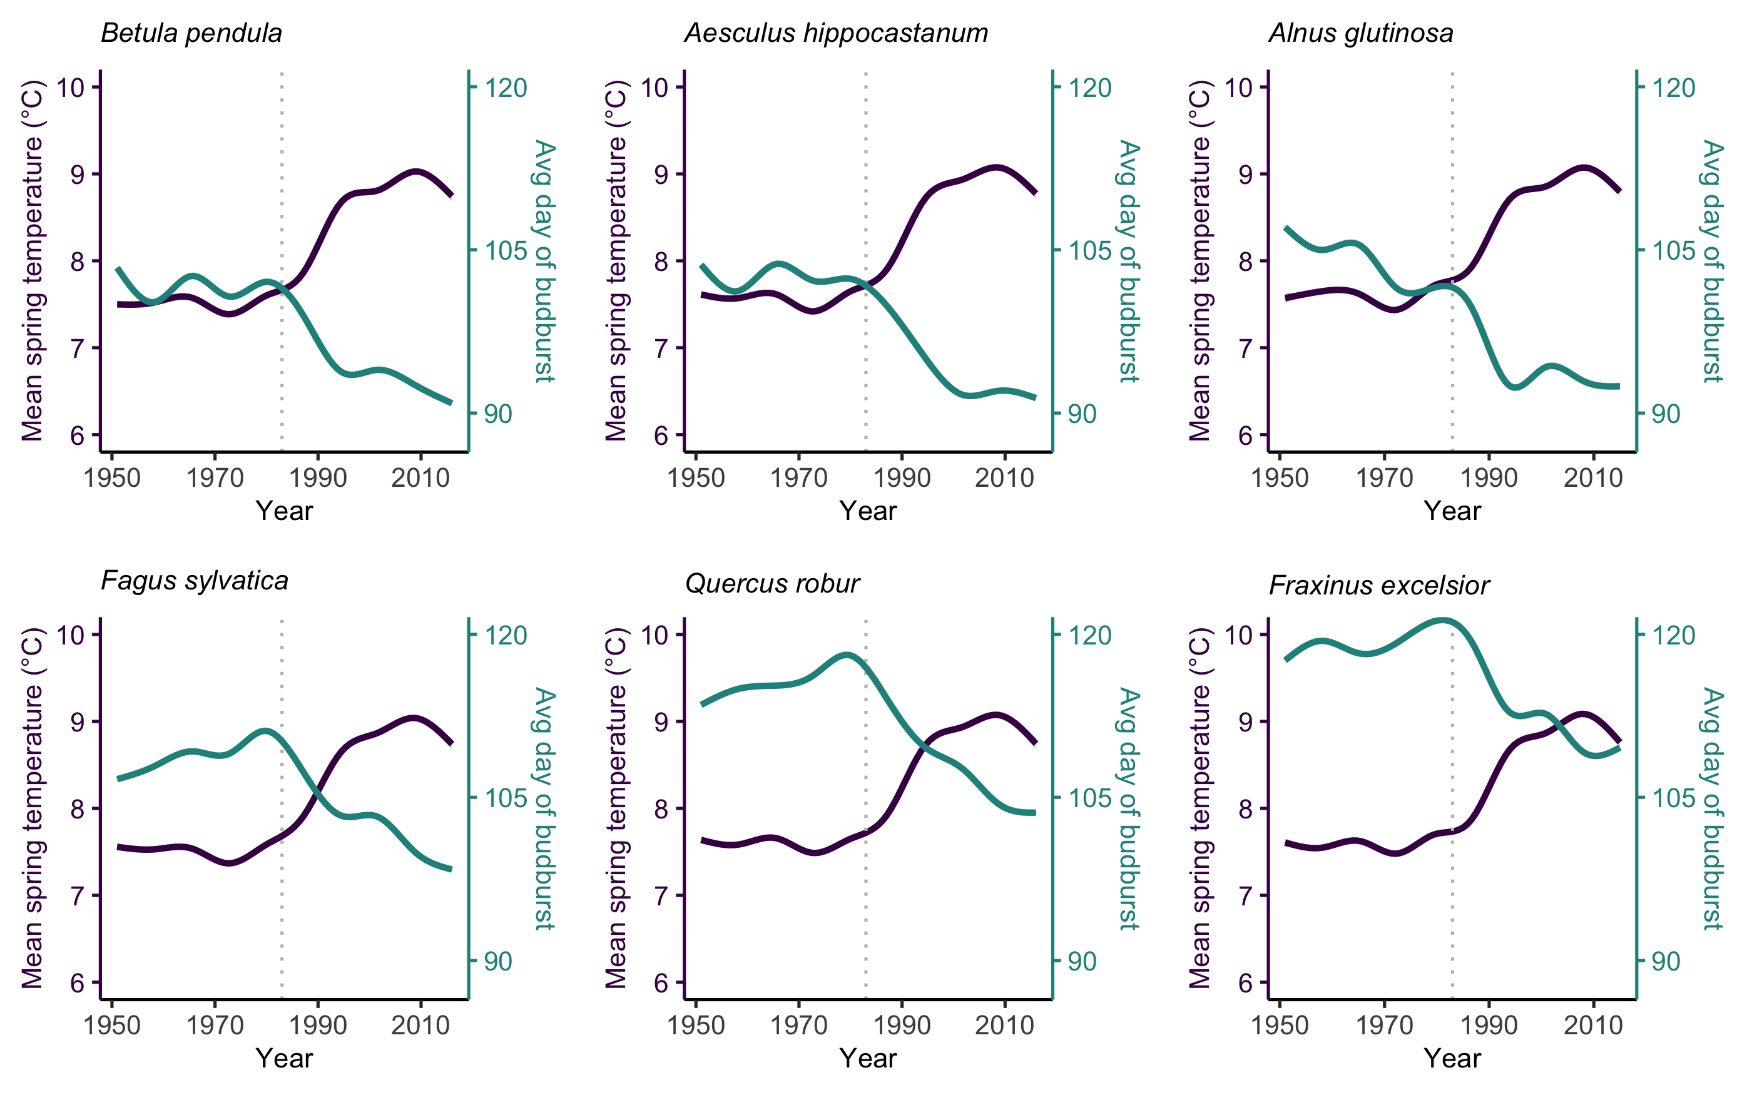
PHENOLOGY IS ADVANCING
Chamberlain et al, New Phytologist

Slide 5
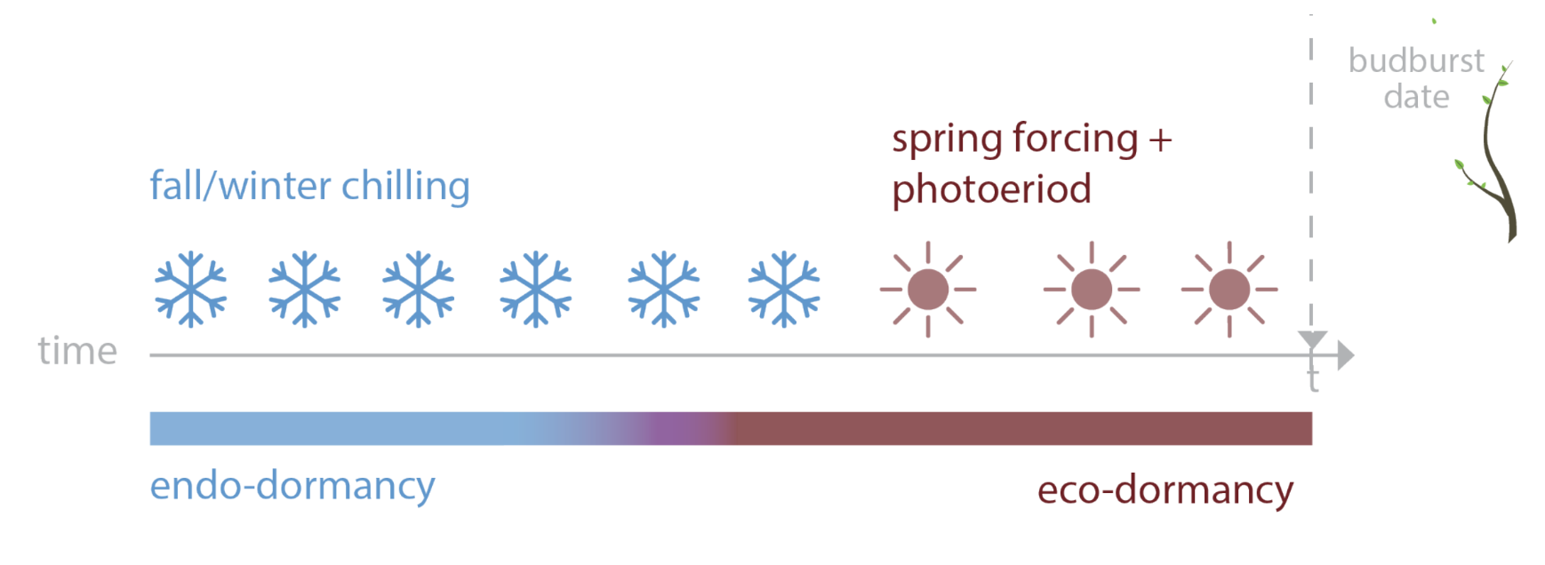
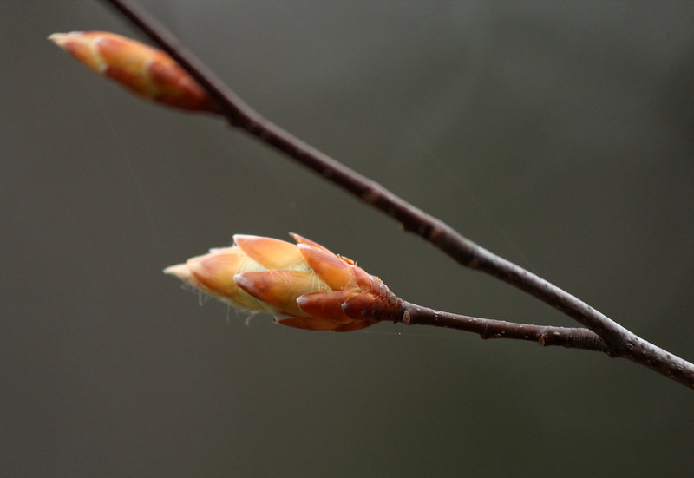
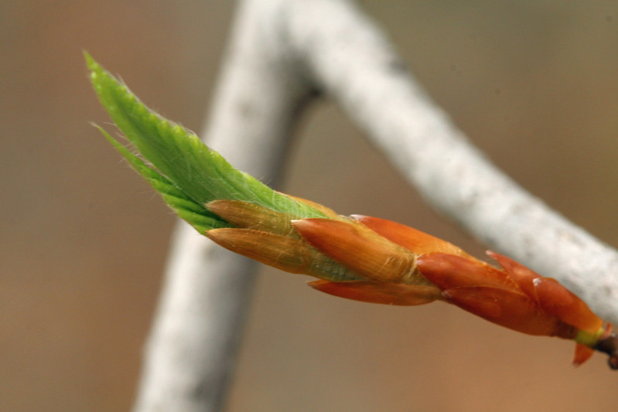
PHENOLOGY USES MULTIPLE CUES
spring warming + daylength
Ettinger, Chamberlain, et al, Nature Climate Change

Slide 6
Growing Degree Days (GDDs)
If temperature is greater than 0℃, then you add up the temperatures
X =
E.g., Temperature is...
5℃ for Day 1
7℃ for Day 2
-2℃ for Day 3
Day 1: 5 – 0 = 5
Day 2: 7 – 0 = 7
Day 3: -2 <= 0 so is 0
So by Day 3, 12 GDDs (5+7) have been accumulated.
T – 0 if T>0
0 if T<=0

Slide 7
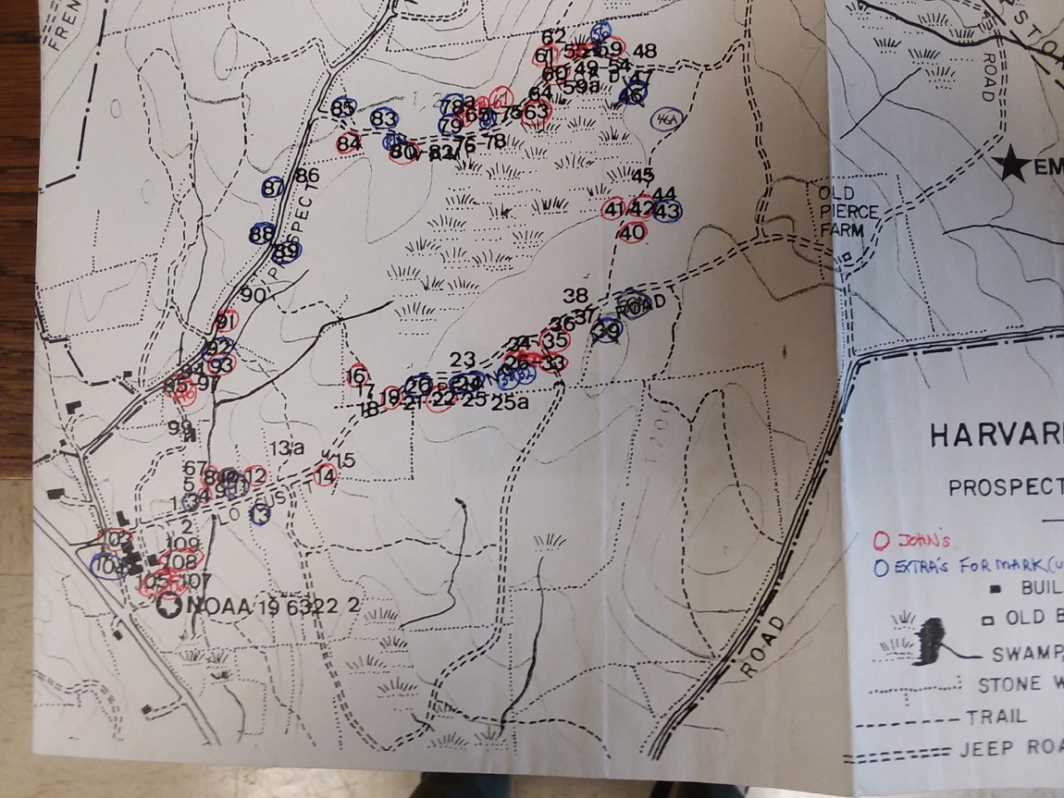

Slide 8
SITE EFFECT
Arboretum
Fagus grandifolia
Harvard Forest
Jan 1
Dec 31

Slide 9
SITE EFFECT
Arboretum
Fagus grandifolia
Harvard Forest
Jan 1
Dec 31

Slide 10
METHOD EFFECT
Hobo Logger
Fagus grandifolia
Weather Station
Jan 1
Dec 31

Slide 11
METHOD EFFECT
Hobo Logger
Fagus grandifolia
Weather Station
Jan 1
Dec 31

Slide 12
Site and Method Effects

Slide 13
SITE EFFECTS

Slide 14
METHOD EFFECTS

Slide 15
INTERACTION

Slide 16
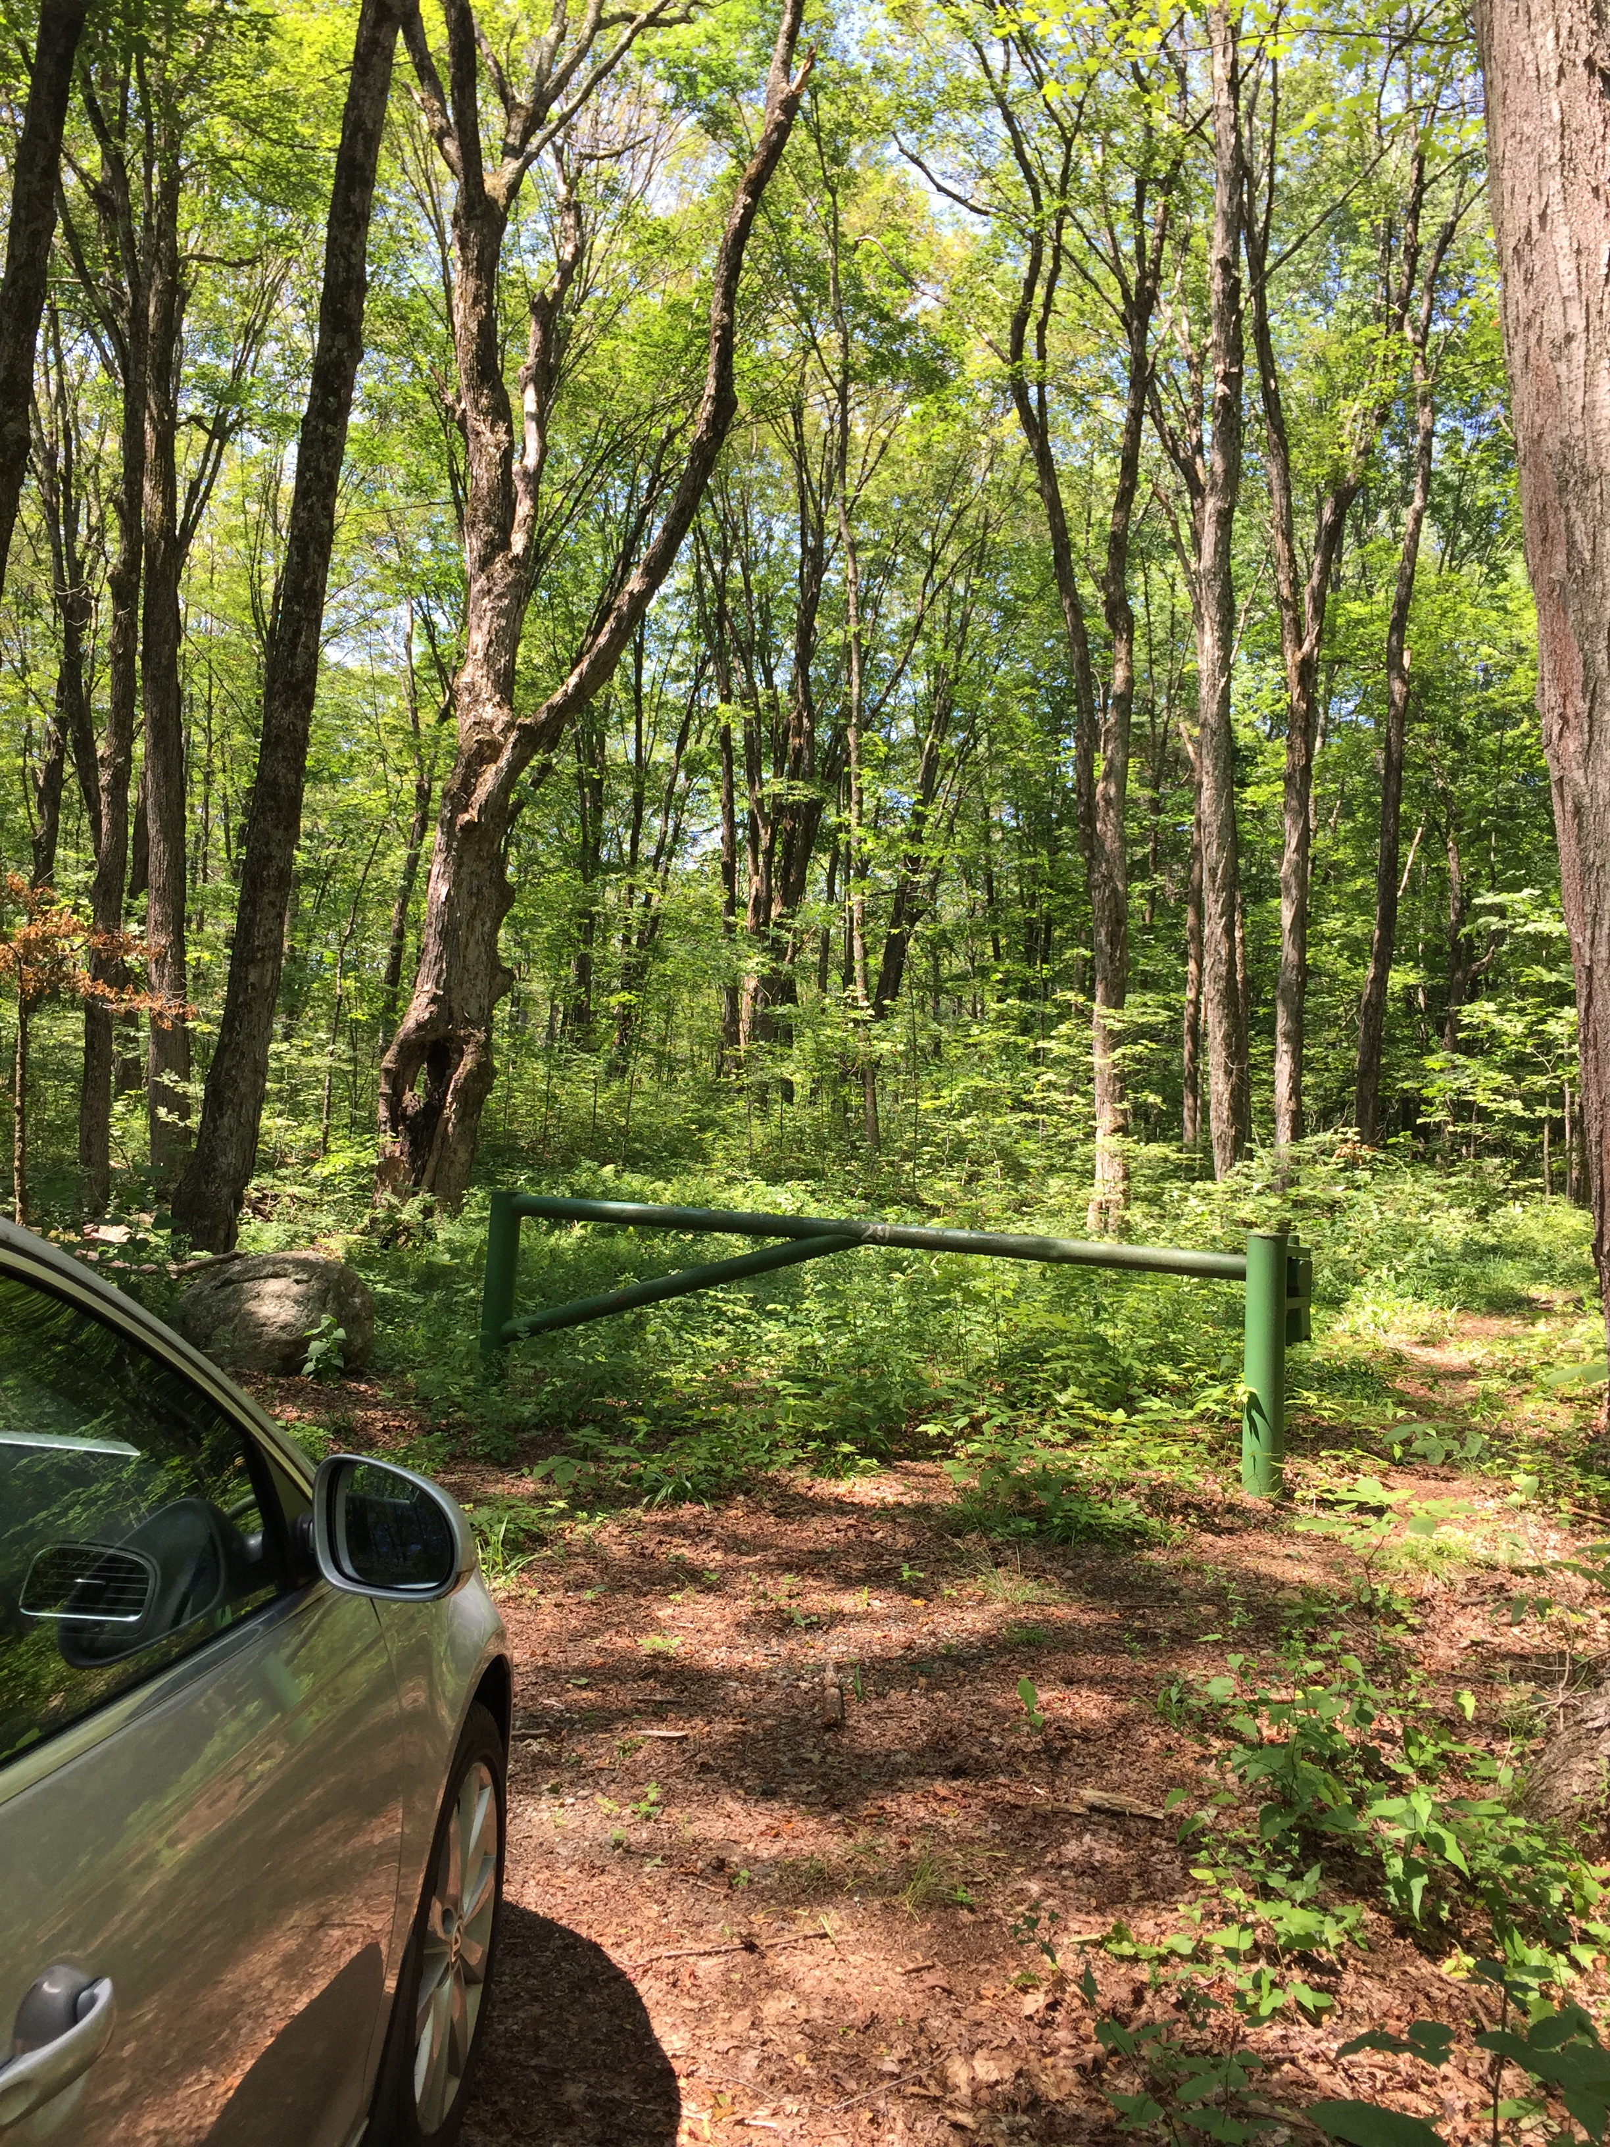
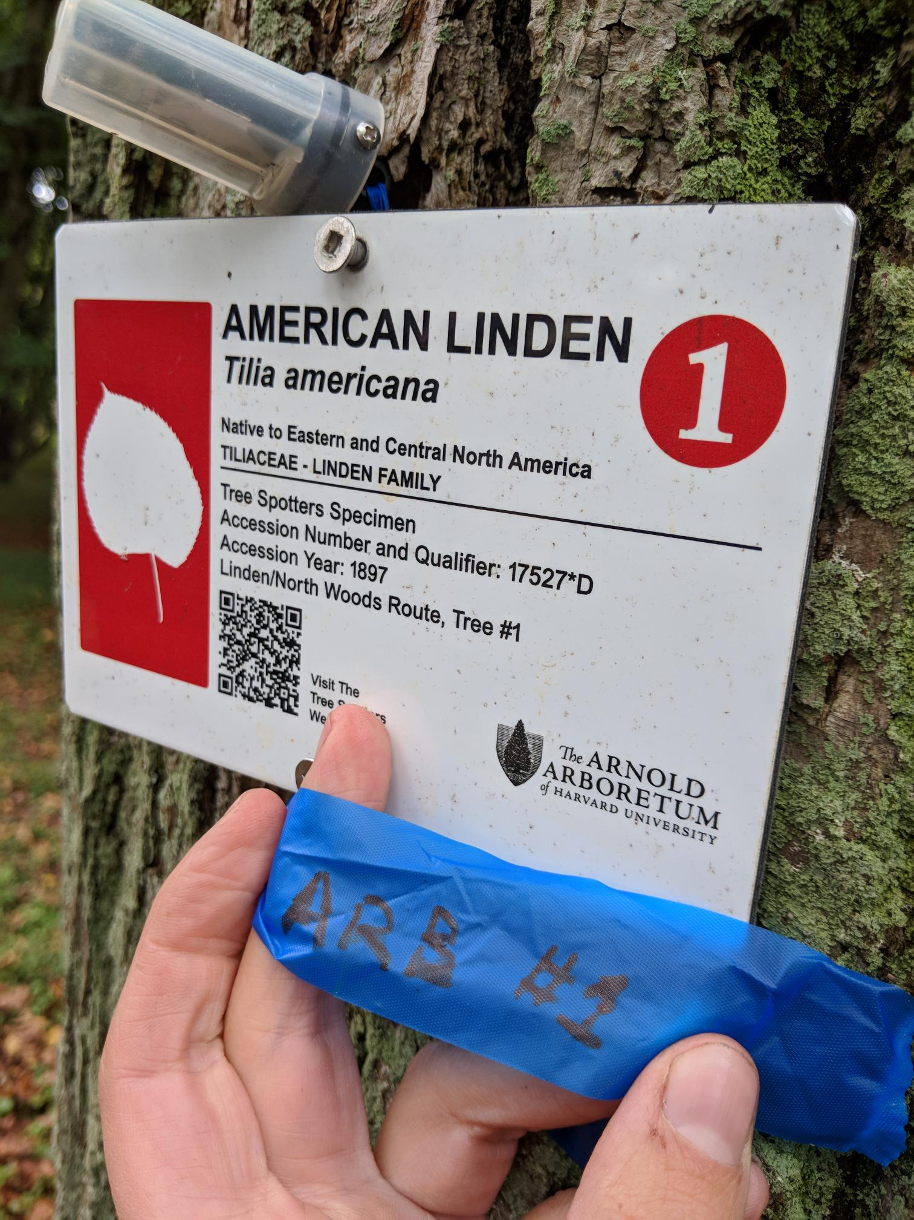
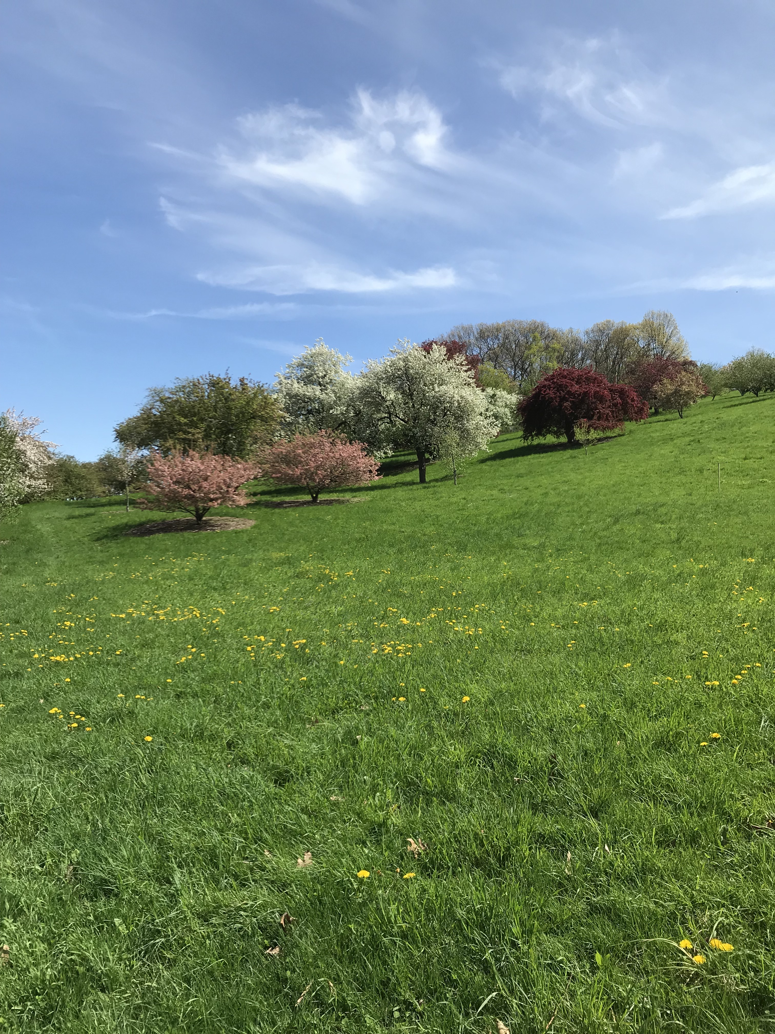
QUICK CONCLUSIONS
GDDs VARY ACROSS SITES
Harvard Forest has more GDDS
GDDS DIFFER BETWEEN METHODS
Hobo loggers record higher GDDS
BUT! We have an interaction
More variation in GDDs at the Arboretum
PHENOLOGY IS FINICKY. More work to be done!

Slide 17
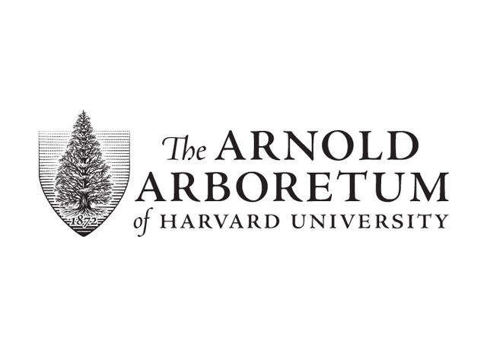








THE TEMPORAL ECOLOGY LAB
Lizzie Wolkovich, PhD
Dan Buonaiuto
Ignacio Morales-Castilla, PhD
Aileen Ettinger, PhD
Deirdre Loughnan
Darwin Sodhi
ARNOLD ARBORETUM - TREE SPOTTERS
Suz Mrozak
Danny Schissler
Kate Stonefoot
Pam Thompson
Our Citizen Scientists!!
COMMITTEE MEMBERS
Paul Moorcroft, PhD
Neil Pederson, PhD
COLLABORATORS AND SPECIAL THANKS
Iñaki Garcia de Cortazar-Atauri, PhD
Ben Cook, PhD
Kea Woodruff
Faye Rosin
Alice Linder
Dan Flynn
Alissandra Ayala
John O’Keefe, PhD
Audrey Barker Plotkin
THE HOLBROOK LAB
Noel Michele Holbrook, PhD
Fulton Rockwell, PhD
Jess Gersony
Anju Manandhar
Meghan Blumstein
Morgan Furze, PhD
Zhe He
Erin Wright

Slide 18
Budburst to leafout
Harvard Forest
Arnold Arboretum

Slide 20
Breakdown of weather data
ARBORETUM
HARVARD FOREST

